Slide 1
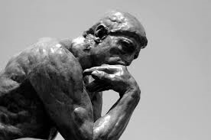


What happens when psychology, philosophy, and economics meet in the lab?
Brock Bastian
ARC Future Fellow
School of Psychology
UNSW

Slide 2
Interdisciplinary experiments….why bother?
By bringing different ideas and methods to bear on a problem we are better able to understand it.
Different disciplines are better at different things
E.g.,
  Philosophy is great for theories and ideas
  Economics provides valuable insights into core drivers of behavior
  Psychology has developed cutting edge approaches to behavioral experimentation
By bridging across these fields we are better able to provide important insights into social issues and human behavior

Slide 3
Overview
Part 1: The meat-paradox
  Philosophy of mind meets psychology of food consumption
Part 2: Pain, justice, and chocolate
  Psychology of pain meets philosophy of justice and consumer behavior
Part 3: Love and money
  Psychology of group formation meets economic decision making

Slide 4
Part 1: The meat-paradox
  97% of Americans are meat-eaters;
  65% in India, the world’s least meat-eating nation
  In 2010 the US meat industry processed 9 billion land animals with sales of $155 billion and salaries, taxes, and revenues accounting for 6% of the US GDP (approx. $864 billion; source American Meat Industry).
  Meat is an excellent source of protein that has been sought out by humans for millennia.
  BUT
  A vast majority of people find animal suffering offensive, emotionally disturbing, and potentially disruptive to their meat-eating habits.

Slide 5
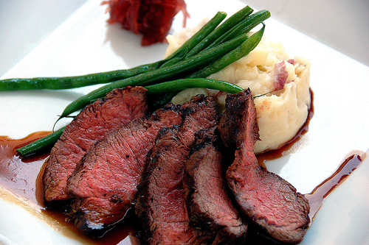
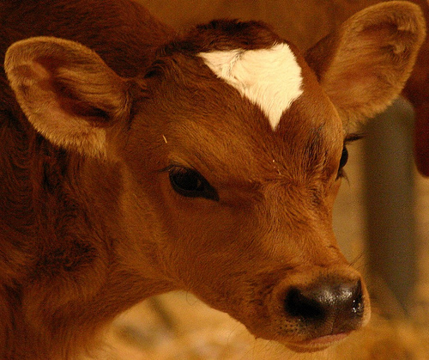
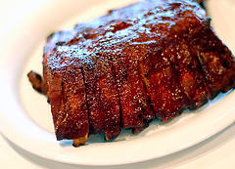
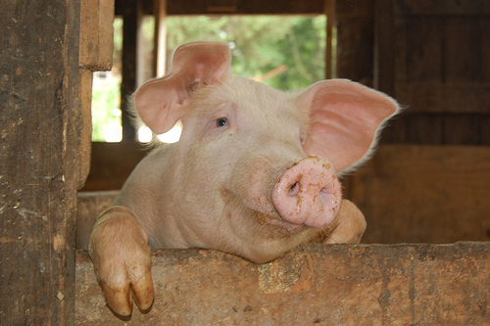
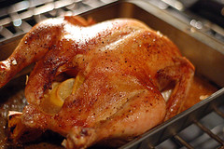
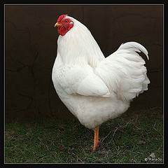

Slide 6
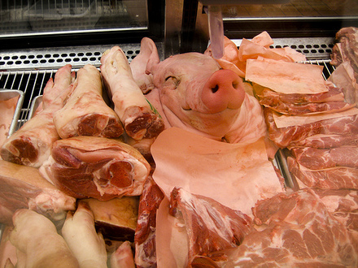
Notes:
We generally do not like to think about where our meat comes from and how it gets to our plates

Slide 7
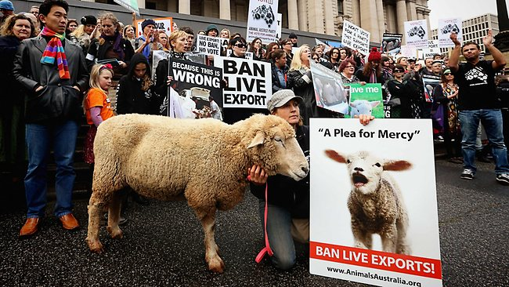
Notes:
When we do think about it, such reminders trigger moral outrage. Of course it is much easier to be outraged when the injustices can be blamed on others rather than on ourselves

Slide 8
Resolving the meat-paradox
To resolve the meat paradox we downplay the mental lives of animals
This makes animals seem less morally relevant and reduces our feelings of concern over their welfare
We enjoy eating meat, but we don’t like eating minds

Slide 9
Study 1: Minds and meat
Edibility
Mind

Slide 10
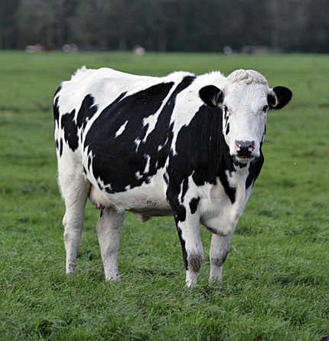
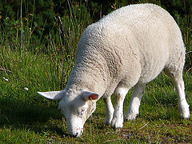
Study 2: Reminders of harm
Provided meat-eaters and vegetarians with reminders of animal harm associated with meat production vs. no reminder (n=123)
Mind Attribution: pleasure, fear, rage, joy, happiness, desiring, wishing, planning, pain, hunger, tasting, seeing, hearing, choosing, thinking, intending, imagining, reasoning

Slide 11
Study 2: Perceptions of meat animal minds

Slide 12
Facilitating behaviour
Denying food animals minds should facilitate untroubled meat consumption and reduces negative affect

Slide 13
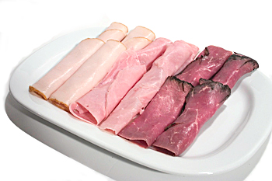
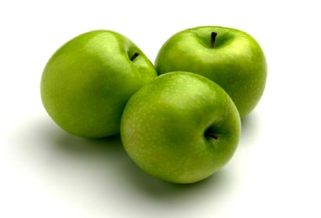
Study 3: Behavioral commitment
T1: Completed mind attribution task
People assigned to eat either beef/lamb or apples (N=128)
T2: Completing Mind attribution task in view of food they expected to eat
Rated mood

Slide 14
Study 3: Mind attribution

Slide 15
Study 3: Affect management
Mind Denial
β=.24, p=.009
β=-.23, p=.015
Condition:
0=fruit sampling, 1=meat sampling
Negative Affect

Slide 16
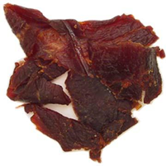
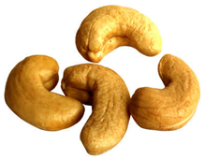
Study 4: Behaviour justification
Participants were asked to eat either beef jerky (n=53) or cashew nuts (n=46).
  Select animals they felt moral concern for from a list of 27.
  Rate their moral concern for a cow (1- not at all; 7- very much).

Slide 17


Study 4: Narrowing of moral concern

Slide 18
Part 2: Pain, justice, and chocolate
The physical experience of pain may be linked to higher order concepts of justice and punishment.
Pain is an early physical experience that is used to ground abstract moral concepts
  E.g., Scaffolding (Williams, Huang, & Bargh, 2009)
Pain grounds abstract concepts of punishment (Glucklich, 2001)
  Pain commonly used as punishment (spanking children, used as negative reinforcement – classical conditioning)
  Latin word for pain – poena – “to pay the penalty”
Painful experiences activate justice related concepts

Slide 19

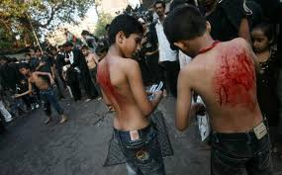
Study 1: Pain and Justice
Pain may be useful in the context of guilt?
  e.g. self-flagellation
Pain may resolve guilt?

Slide 20
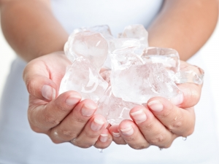
Study 1: Pain and Justice
N=59
3 conditions: “Unethical Pain” / “Unethical no-pain” / “Control Pain”
Mental Acuity – ‘Unethical deed’ vs. ‘Everyday experience’
  PANAS T1
Physical Acuity – Ice water vs. Warm water
  PANAS T2
Bastian, Jetten, & Fasoli. (2011). Psychological Science.
Notes:
We again tested this in the lab in a study on what we refer to as the Flagellation effect.........

Slide 21

Study 1: Pain and Justice
Guilty participants held hand in ice-bath longer (M=87secs) than non-guilty participants (M=64 secs) (p<.05)
But, rated the ice-bath as more painful (p<.006)
They sought out pain!
Bastian, Jetten, & Fasoli. (2011). Psychological Science.

Slide 22
Study 1: Pain resolves guilt
F(2,55)=3.60, p=.034)
Guilt
Bastian, Jetten, & Fasoli. (2011). Psychological Science.

Slide 23
Study 1: Pain resolves guilt
F(2,55)=3.60, p=.034)
Guilt
Bastian, Jetten, & Fasoli. (2011). Psychological Science.

Slide 24
Study 1: Pain resolves guilt
F(2,55)=3.60, p=.034)
Guilt
Bastian, Jetten, & Fasoli. (2011). Psychological Science.

Slide 25
Study 2: Pain and Chocolate
Pain reduces guilt after unethical deeds - what happens when good people experience (unjust) pain?
  People feel justified and less guilty about indulging in self-rewarding behavior when they have been the victims of injustice (Austin & Walster, 1975; Davis, 1945; Freud, 1917; Zitek, Jordan, Monin, & Leach, 2010).
  In these contexts self-indulgence provides for a sense of justice (e.g., Lerner, 1975; 1980) thereby annulling feelings of guilt.

Slide 26
Study 2: Pain and self-indulgence
58 undergraduates
3 conditions: “Ethical Pain” / “Unethical Pain” / “Ethical No-Pain”
  Mental Acuity – ‘ethical deed’ vs. ‘unethical deed’
  Physical Acuity – Ice water vs. Warm water
Offered bowl of sweets (n=75: 5 different types)
  “I was going to give these to you at the end, but I’ll give them to you now while I’m away. Please feel free to take some to take with you”
Bastian, Jetten, & Stewart (2013) Social Psychological and Personality Science

Slide 27
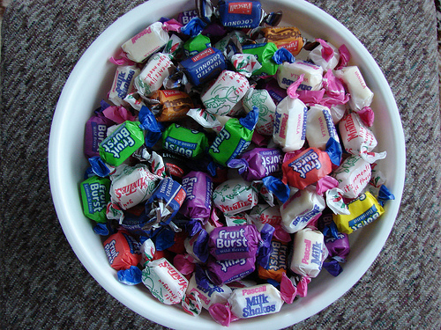
Study 2: Pain and self-indulgence
F(2,55)=3.60, p=.034)
Bastian, Jetten, & Stewart (2013) Social Psychological and Personality Science
Notes:
What we found was that compared to the other conditions participants who wrote about a past ethical deed and experienced pain took more sweets.

Slide 28
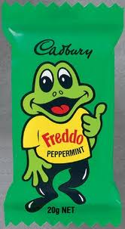
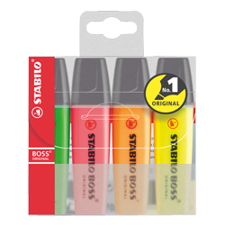
Study 3: Pain and self-indulgence
Does pain motivate indulgence in “guilty pleasures”
V’s
Bastian, Jetten, & Stewart (2013) Social Psychological and Personality Science

Slide 29
Study 3: Pain and self-indulgence
49 undergraduates
2 conditions: Pain vs. No Pain
Offered bowl with 10 x Highlighter’s and 10 x Carmelo Koala’s
  “I was going to give these to you at the end, but I’ll give them to you now while I’m away. Please feel free to take one gift with you”
Bastian, Jetten, & Stewart (2013) Social Psychological and Personality Science

Slide 30
Study 3: Pain and self-indulgence
X² (1, N=48)=5.60, p=.018
Bastian, Jetten, & Stewart (2013) Social Psychological and Personality Science

Slide 31
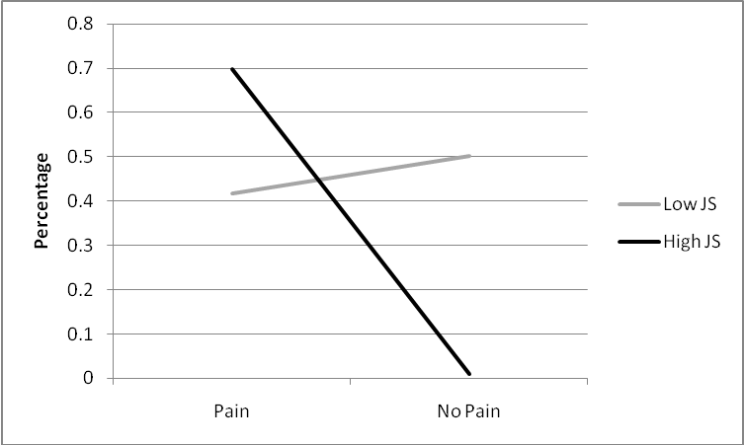
Study 3: Pain and self-indulgence
Moderated by sensitivity to personal injustice
B=3.59, OR=36.12, WaldX²=4.06, p=.044
Bastian, Jetten, & Stewart (2013) Social Psychological and Personality Science

Slide 32
Part 3: Love and Money
What kinds of experiences bond people together?
Emile Durkheim (1912) argued that painful experiences enhance human cooperation (see also Whitehouse & Lanman, in press)
Anecdotal evidence?

Slide 33
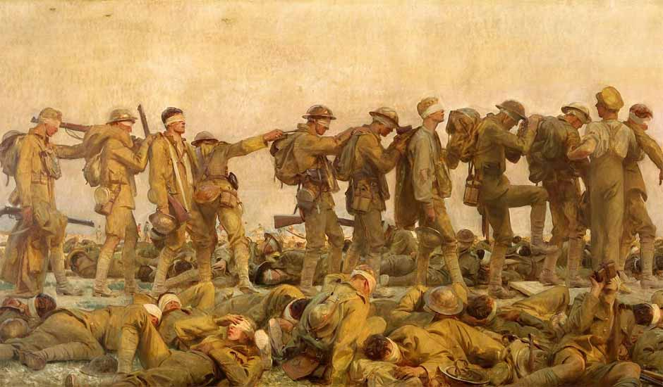
Pain and camaraderie
Notes:
John Singer Sargent – “Gassed”

Slide 34
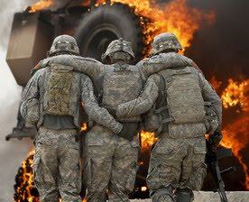
Pain and camaraderie

Slide 35
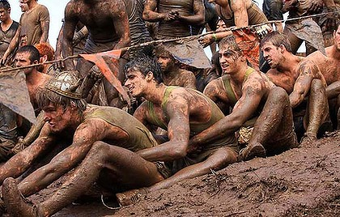
Pain and camaraderie

Slide 36


Pain and camaraderie
Notes:
Polar Bear Plunge

Slide 37
Study 1: Group Bonding
N=53
Groups of two to five people (M^{size}= 3.65)
Pain vs. No-pain
  Modified cold-pressor task + Leg squat task
Bastian, Jetten, & Ferris (2014) Psychological Science

Slide 38
Study 1: Group Bonding
1. I feel a sense of solidarity with the other participants
2. I feel connected to the other participants
3. I feel part of this group of participants
4. I feel a sense of loyalty to the other participants
5. I feel I can trust the other participants
6. I feel that the participants in this study have a lot in common
7. I feel that like there is unity between the participants in this study
Bastian, Jetten, & Ferris (2014) Psychological Science

Slide 39
Study 1: Group Bonding
F(1,51)=4.09, p=.048, d=0.54
Bastian, Jetten, & Ferris (2014) Psychological Science

Slide 40
Study 2: Money
N=62
Groups of two to six people (M^{size}= 3.54)
Pain vs. No-pain
  Modified cold-pressor task + Leg squat task
Trust measure
Bastian, Jetten, & Ferris (2014) Psychological Science

Slide 41
Study 2: Money
Number chosen by you | Lowest number chosen in the group
 | 1 | 2 | 3 | 4 | 5 | 6 | 7
1 | $4.20
2 | $3.60 | $4.80
3 | $3.00 | $4.20 | $5.40
4 | $2.40 | $3.60 | $4.80 | $6.00
5 | $1.80 | $3.00 | $4.20 | $5.40 | $6.60
6 | $1.20 | $2.40 | $3.60 | $4.80 | $6.00 | $7.20
7 | $0.60 | $1.80 | $3.00 | $4.20 | $5.40 | $6.60 | $7.80
Bastian, Jetten, & Ferris (2014) Psychological Science

Slide 42
Study 2: Money
F(1,60)=7.81, p=.007, d=0.72
Bastian, Jetten, & Ferris (2014) Psychological Science

Slide 43
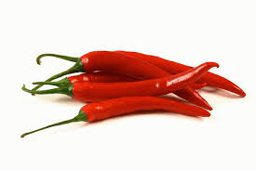
Study 3: Money

Slide 44
Study 3: Money
N=57
Groups of two to five people (M^{size}= 2.84)
Pain vs. No-pain
  Birds eye chili vs. Boiled Sweet
Trust measure
Bastian, Jetten, & Ferris (2014) Psychological Science

Slide 45
Study 3: Money
F(1,55)=4.09, p=.048, d=0.53
Bastian, Jetten, & Ferris (2014) Psychological Science

Slide 46
Studies 2 & 3: Money
Bastian, Jetten, & Ferris (2014) Psychological Science

Slide 47
What have we achieved?
By bringing philosophy, economics and psychology (should probably mention sociology and anthropology) into the lab we have achieved a number of important outcomes
  We have provided new evidence for things we did not know
  We have confirmed things that we thought we did know, but did not have casual evidence for
  We have contributed to the body of knowledge across a number of disciplines

